Slide 1




MMBind: Unleashing the Potential of Distributed and Heterogeneous Data for Multimodal Learning in IoT
Xiaomin Ouyang¹*, Jason Wu²*, Tomoyoshi Kimura³, Yihan Lin², Gunjan Verma⁴
Tarek Abdelzaher³, and Mani Srivastava^{2#}
¹Hong Kong University of Science and Technology, ²University of California, Los Angeles,
³University of Illinois Urbana-Champaign ⁴U.S. Army DEVCOM Army Research Laboratory
*Equal contribution
#Associated with Amazon, but work unrelated to Amazon

Slide 2
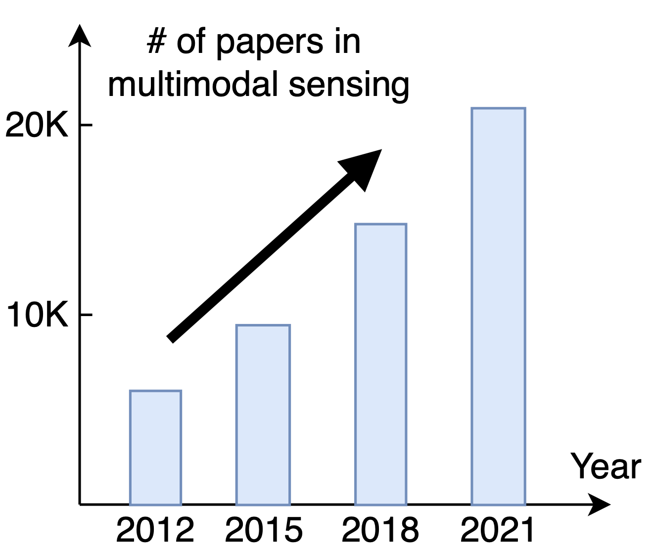
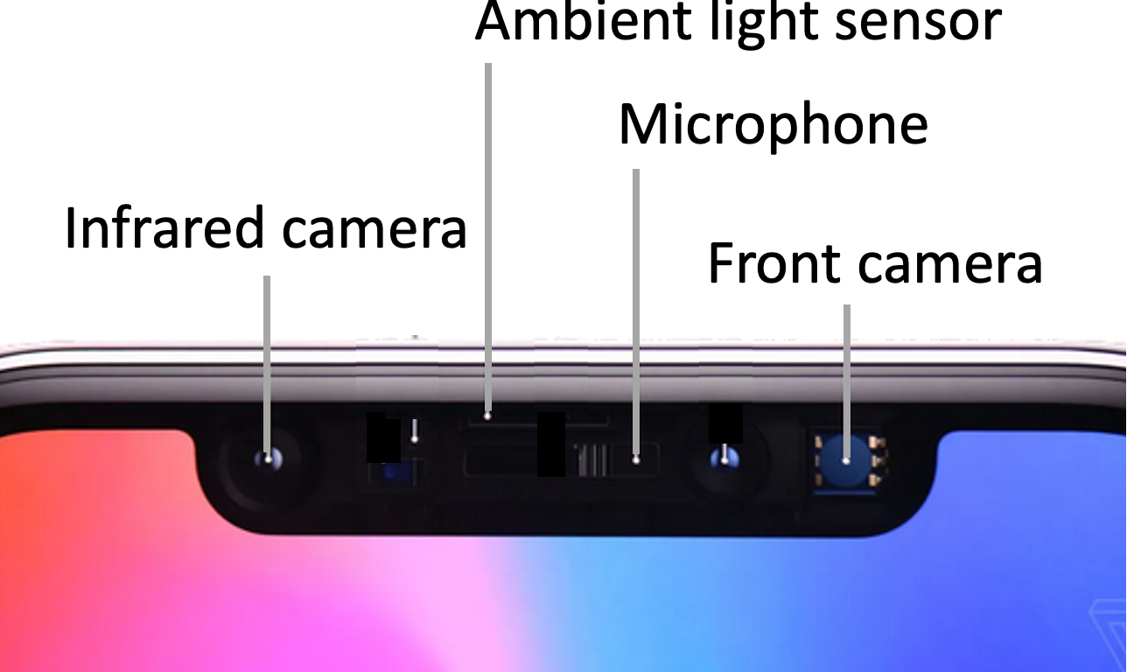

Multi-Modal Sensing and Learning
VR devices
Smartphone
Autonomous vehicle

Slide 3
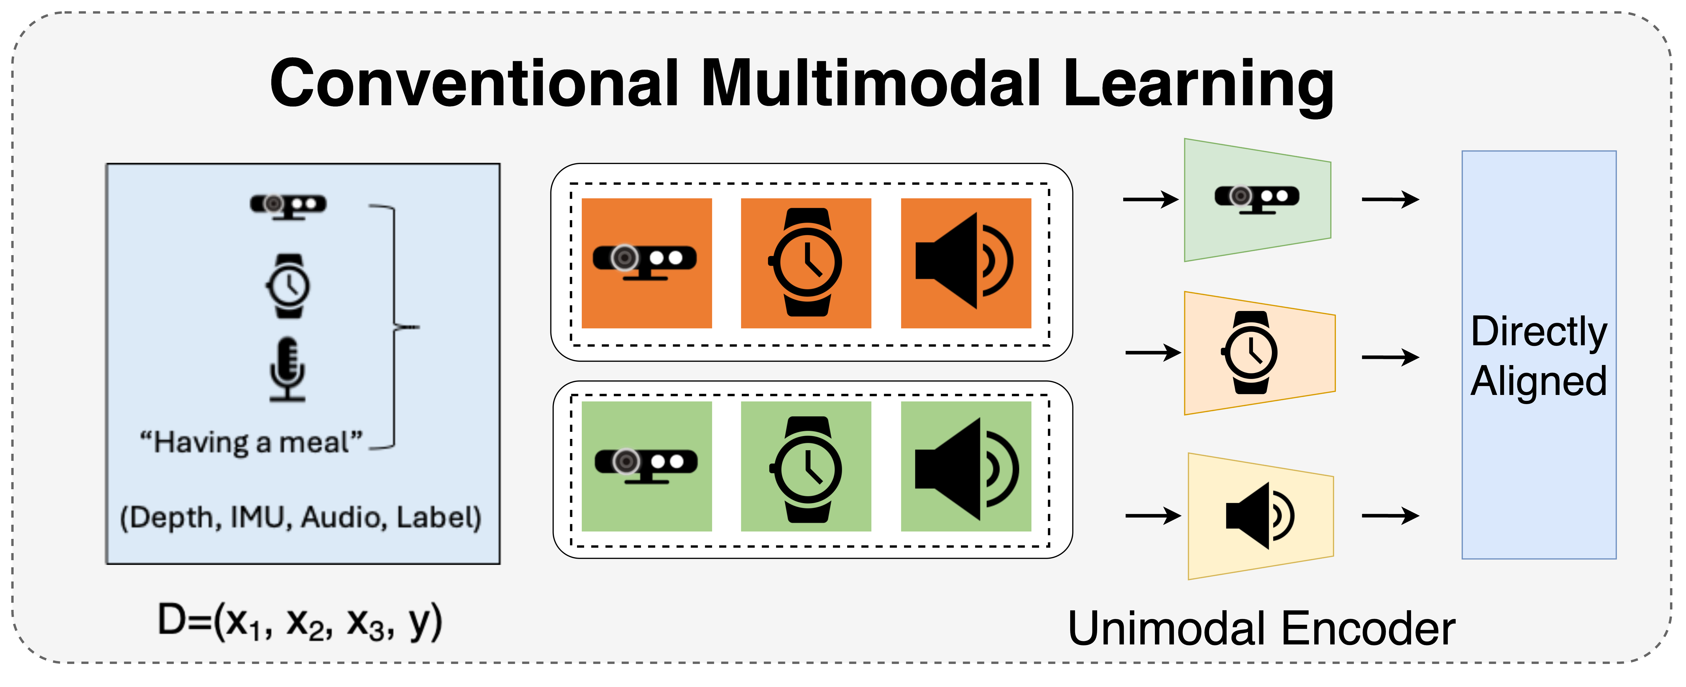
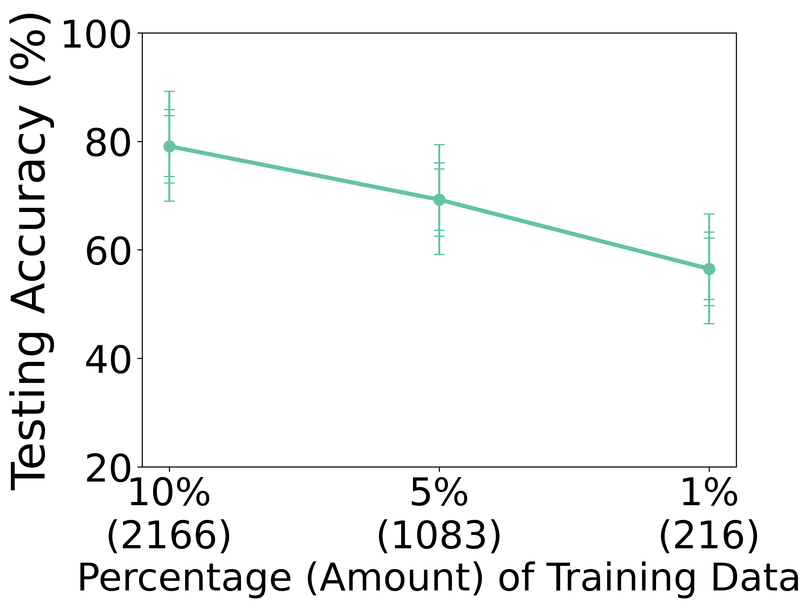
Learning Multimodal Joint Embeddings
Align different modalities in the feature space
Accuracy drop with less paired data
Require lots of complete and synchronized multimodal data

Slide 4
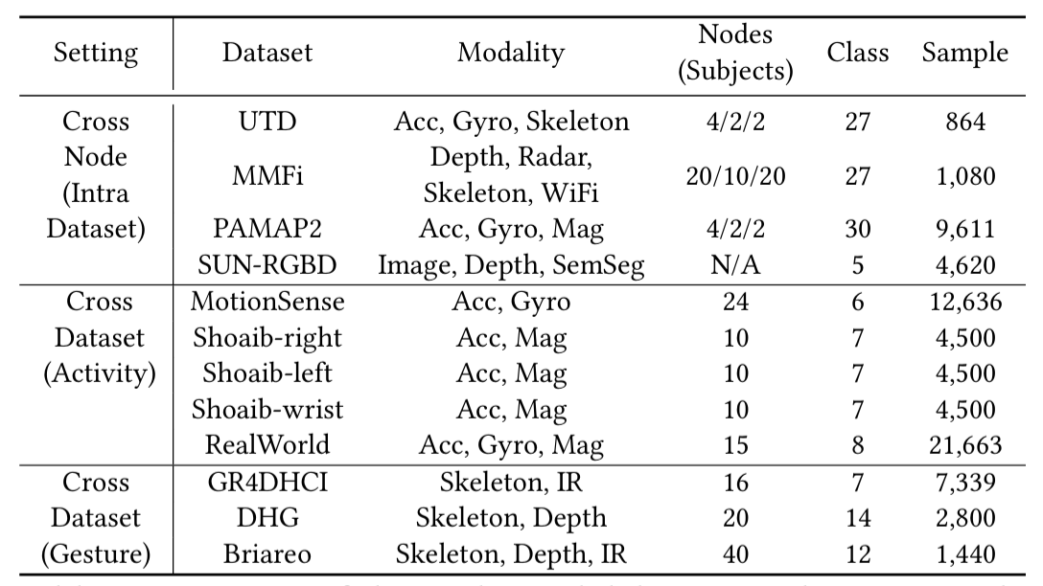
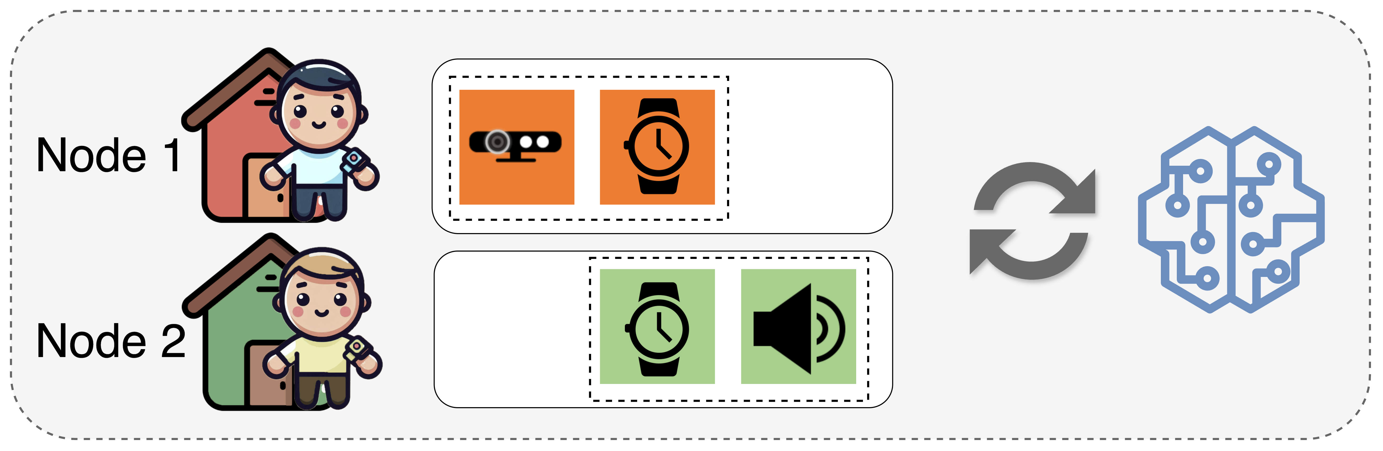
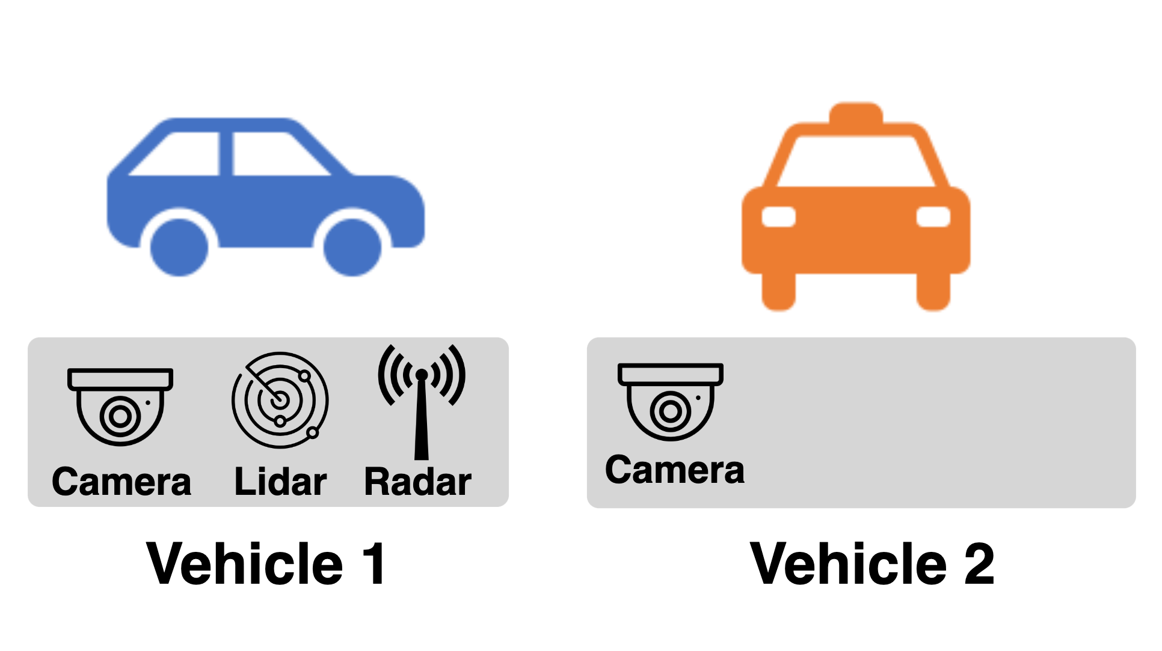
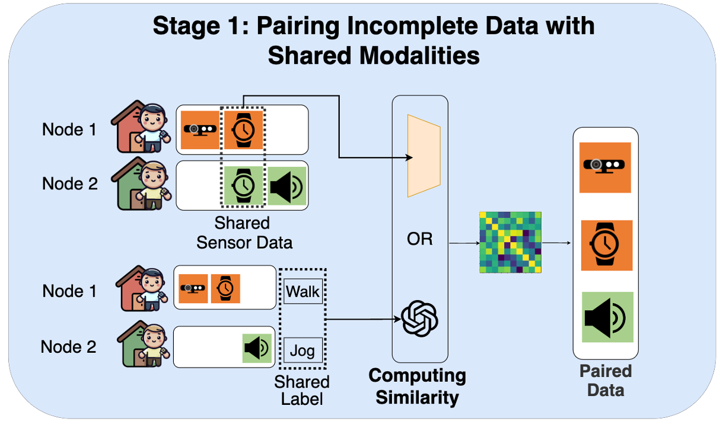
Multimodal Learning in IoT: Challenges
Incomplete and heterogeneous
Key question: Can we learn joint multimodal embeddings with small, distributed and incomplete data in IoT?
Modality missing
Label missing
D1=(x₁, y), D2=(x₂, y)
D1=(x₁, x₂), D2=(x₂, x₃)
Distribution shift
Collected by nodes at different times and locations
Small and Distributed Data in IoT

Slide 5
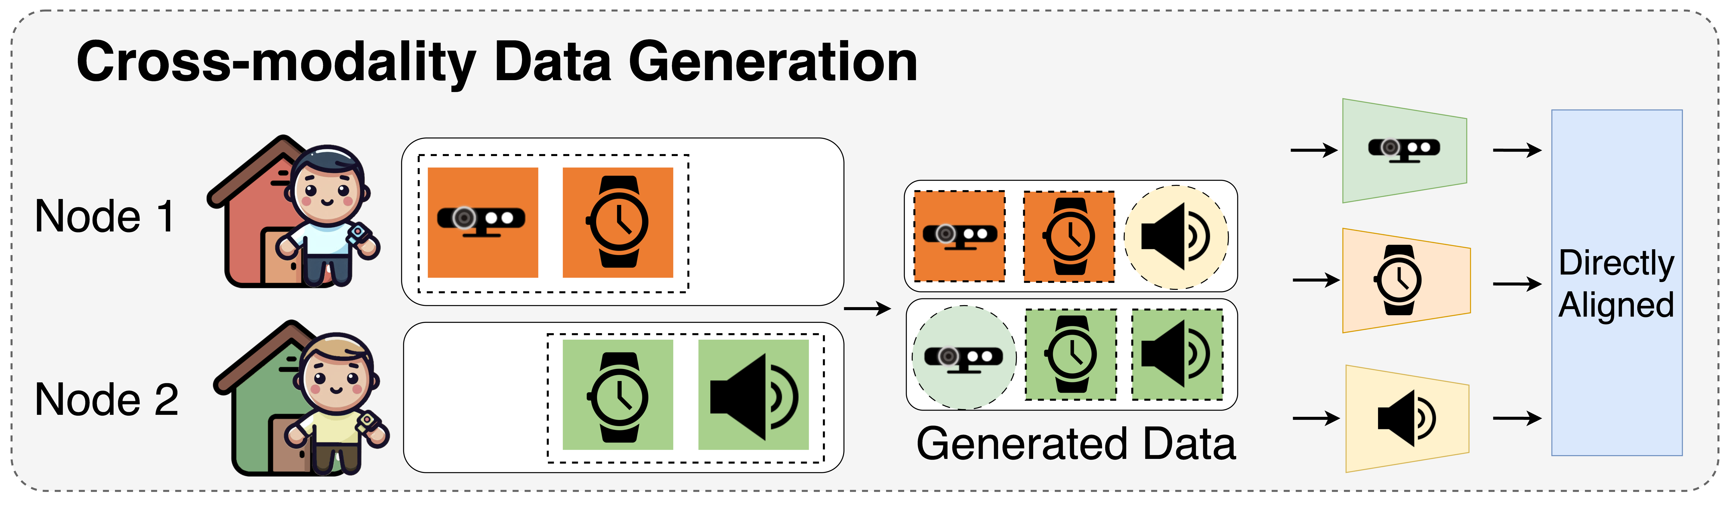
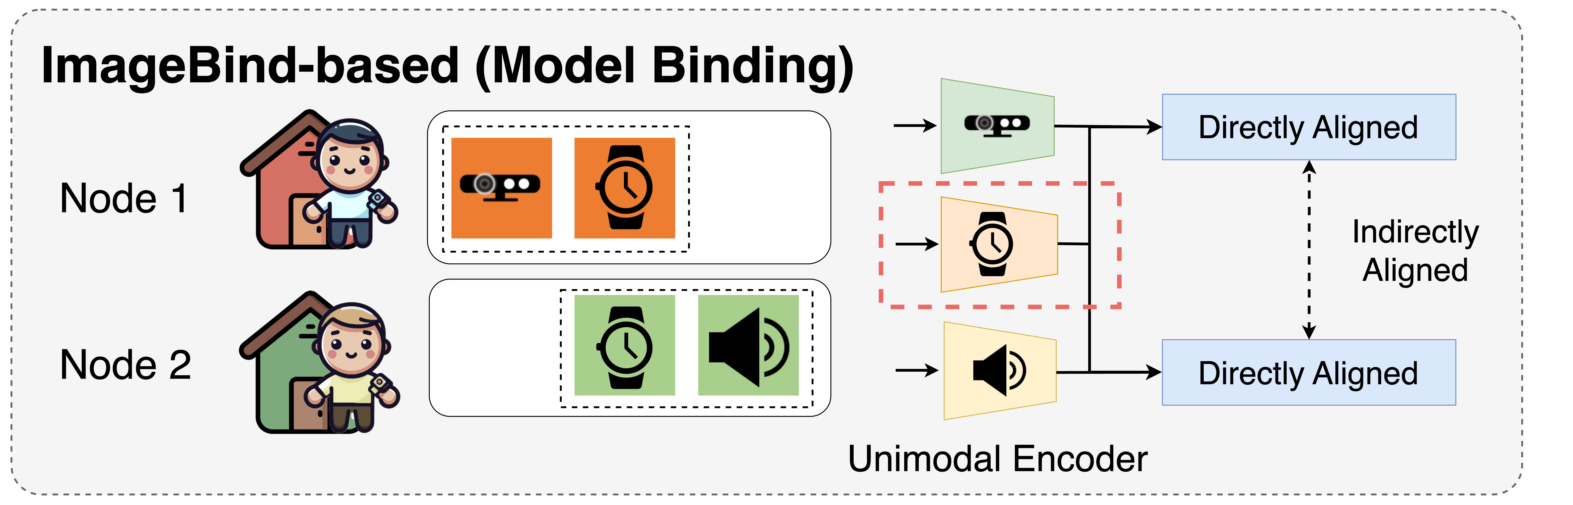
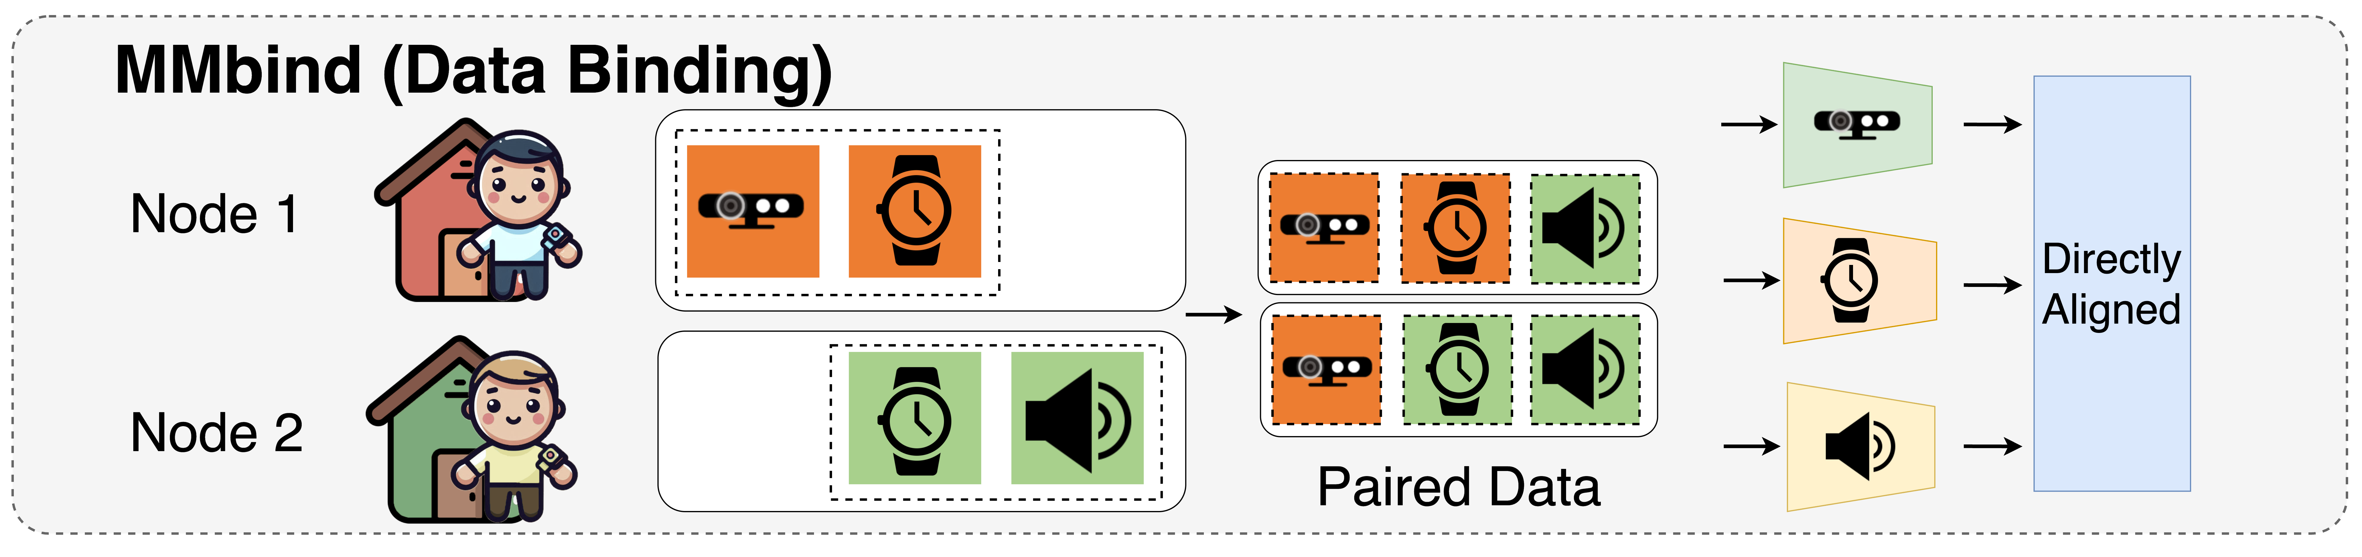
Current Solutions
Cross-modality Generation
Model-binding Approaches
Insufficient multimodal paired sensor data
Indirectly aligned through transitivity
Key idea: Bind data from disparate sources and incomplete modalities with the shared modality
Shared modality: sensor data or labels

Slide 6
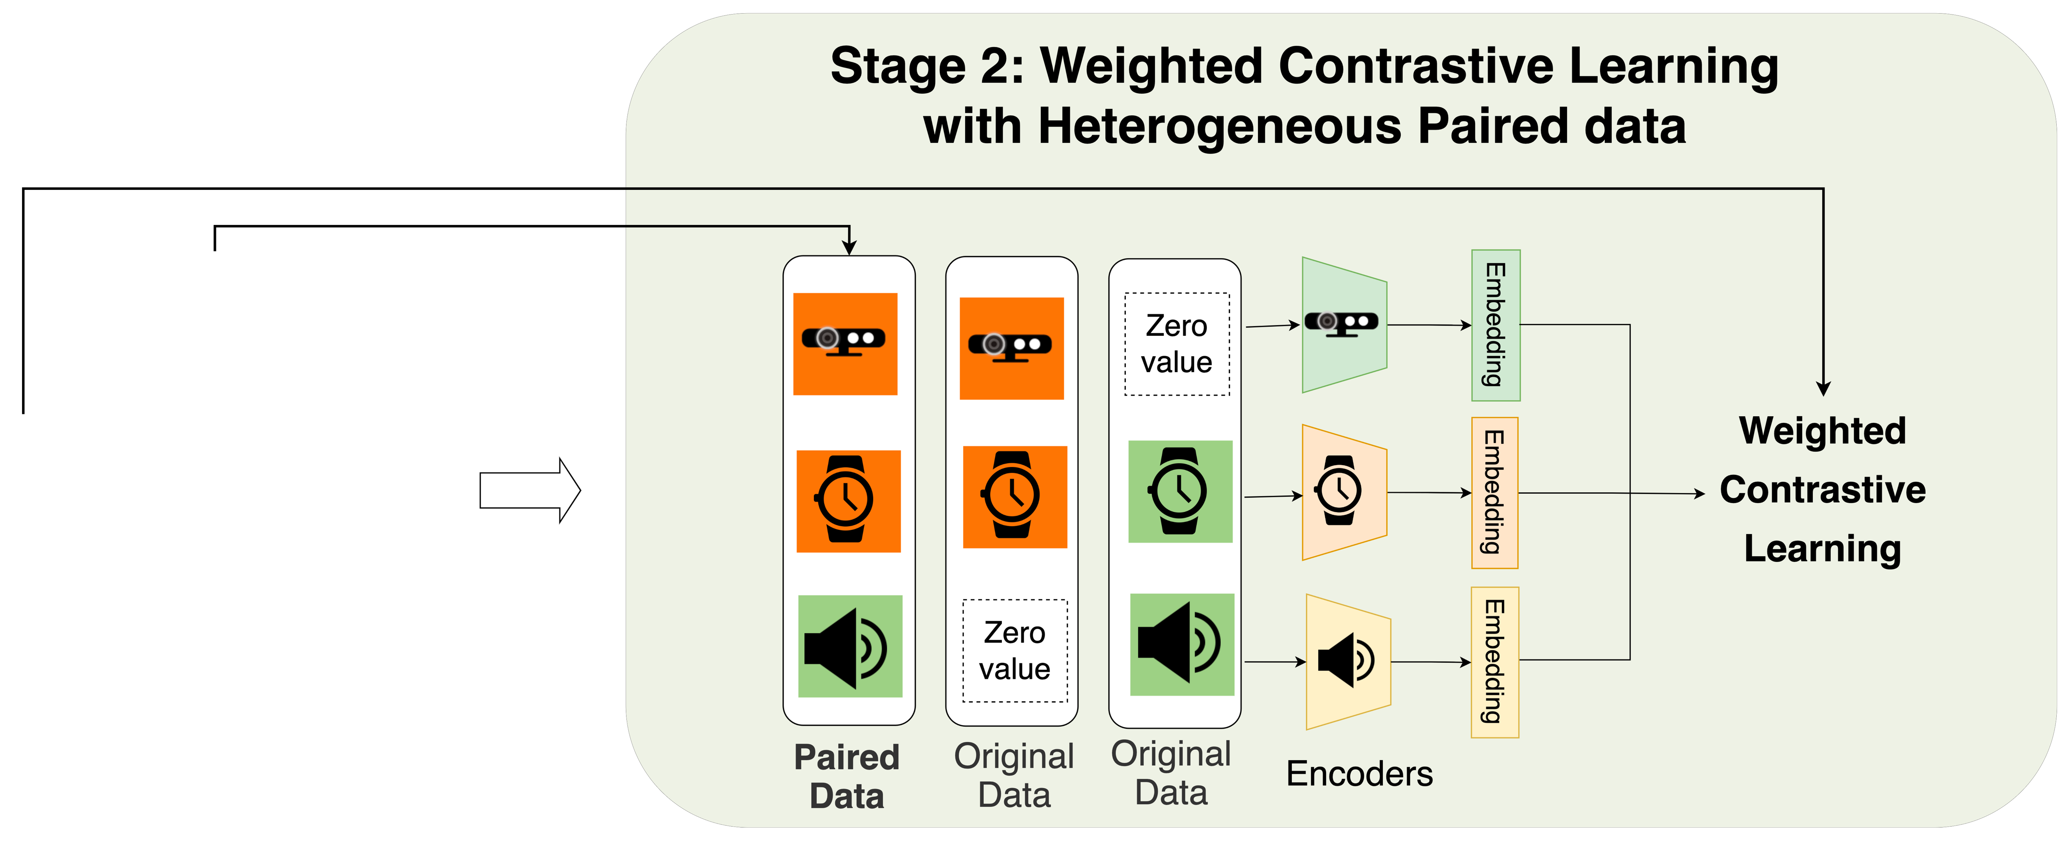
MMBind: Data Binding for Multimodal Learning in IoT
Construct Pseudo-Paired Data
Learning with Heterogeneous Paired Data
Imperfect paring
Data of different modalities observing similar events can be effectively used for multimodal training.

Slide 7
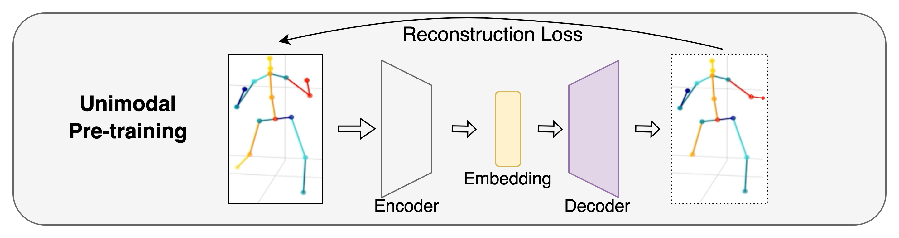
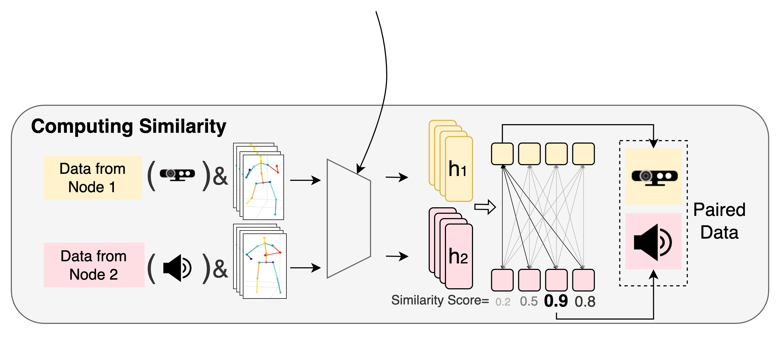
Stage 1: Pairing Incomplete Data with Shared Modalities
Unsupervised Encoder Training of the Shared Modality
Semantically structured [1,2]
No similarity bias like in contrastive learning
Generating Pseudo-Paired Data based on the Similarity Measurement
Label as the shared modality: use LLMs for similarity measurement
[1] SALSA: Semantically-Aware Latent Space Autoencoder. AAAI 2024 [2] Variational Autoencoder with Learned Latent Structure. AISTATS 2021.

Slide 8
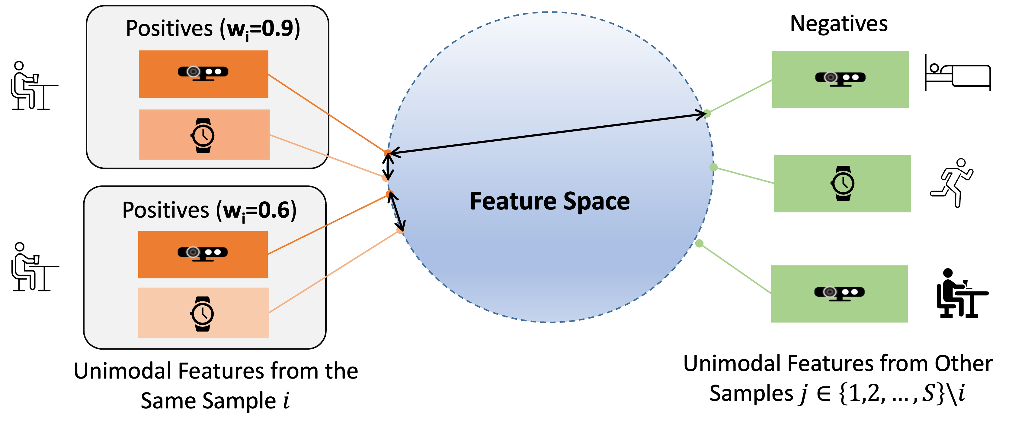
Stage 2: Weighted Contrastive Learning with Heterogeneous Paired Data
Weighted Contrastive Learning based on Pairing Similarity
Contrastive Learning across Modalities
Accommodate diverse degrees of similarities among pseudo-paired data samples.
Emphasize data samples with a higher similarity

Slide 9
Evaluation Setup
Datasets
Baselines
Unimodal Learning (Unimodal)
Multimodal Learning with Incomplete Modality (MIM)
Modality Prompting for Missing Modality (MPM )
Cross-Modality Generation (CMG)
Dual Contrastive Multimodal Learning (DCM)
ImageBind
Lower Bound: ignore paired data
Theoretical Upper Bound: naturally paired data
Edge implementation
10 real-world datasets, 9 distinct modalities
Cross-node and cross-dataset binding
Nvidia Jetson Tx2

Slide 10
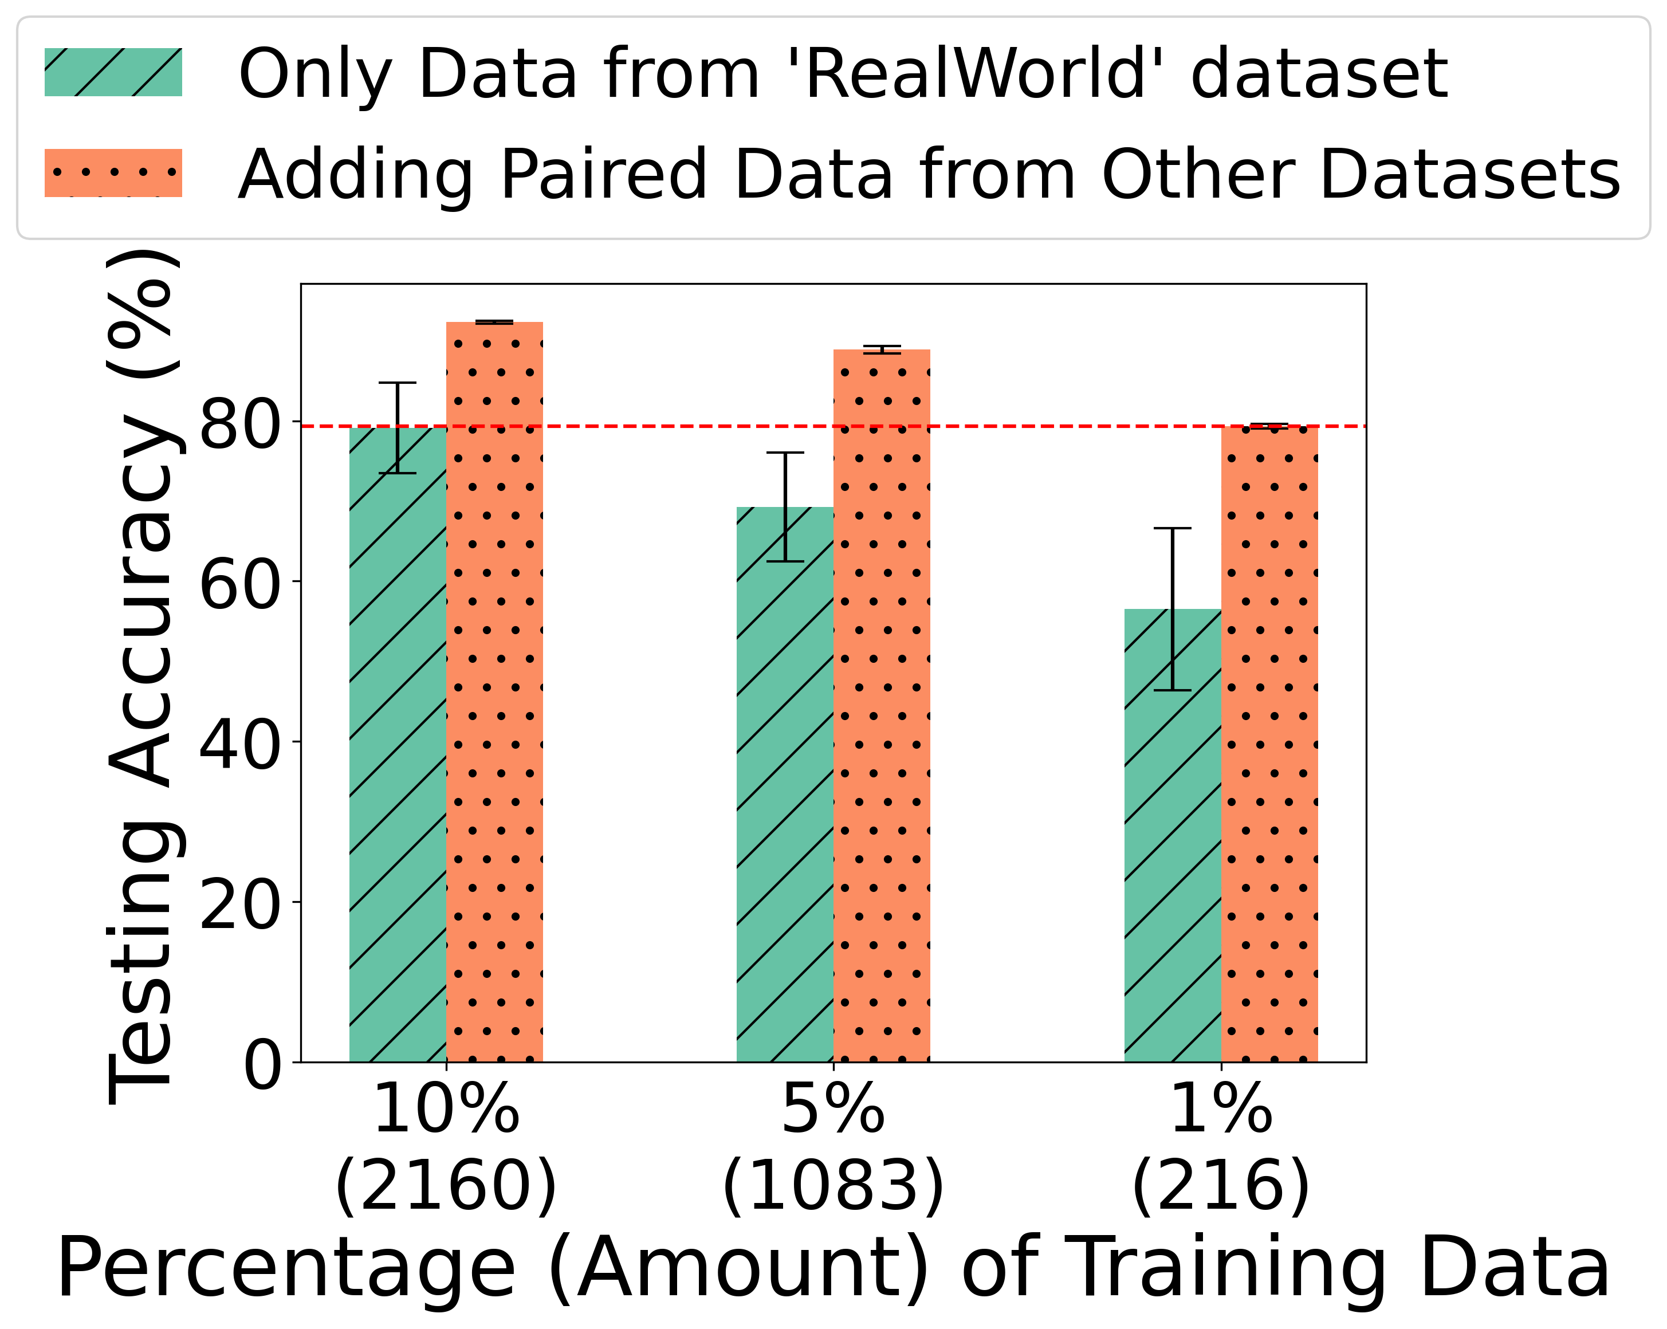
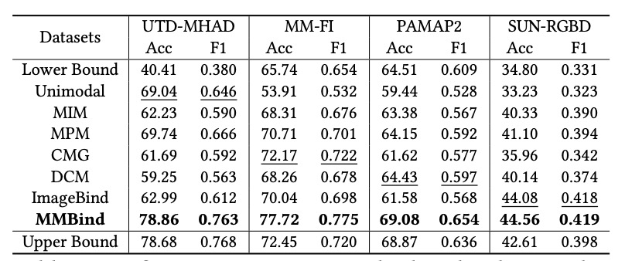
Evaluation: Overall Performance
Cross-Node Binding
Cross-Dataset Binding
Adding pseudo-paired data samples significantly boosts model performance.

Slide 11
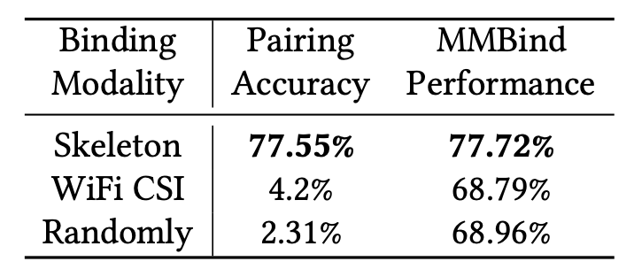
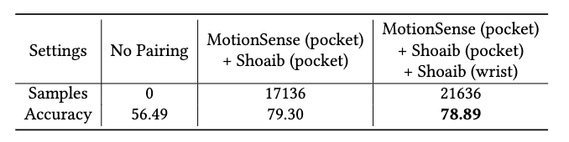
Evaluation: Impact of Binding Modalities
Different sensors
Same sensor (IMU), different placements
The binding modality should:
effectively distinguish events
describe same feature of the event

Slide 12
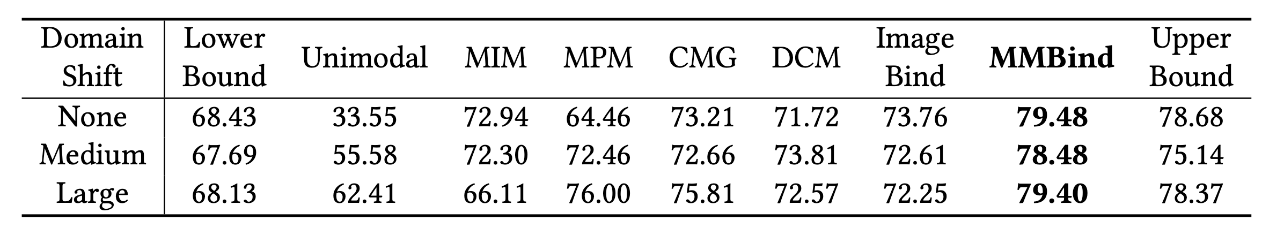
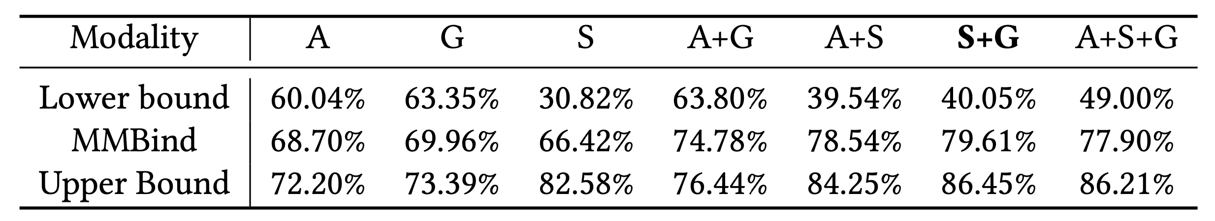
Evaluation: Robustness of Multimodal Embeddings
Domain shifts
Different modality combinations
Pre-trained on paired S+G (Skeleton, Gyro).

Slide 13
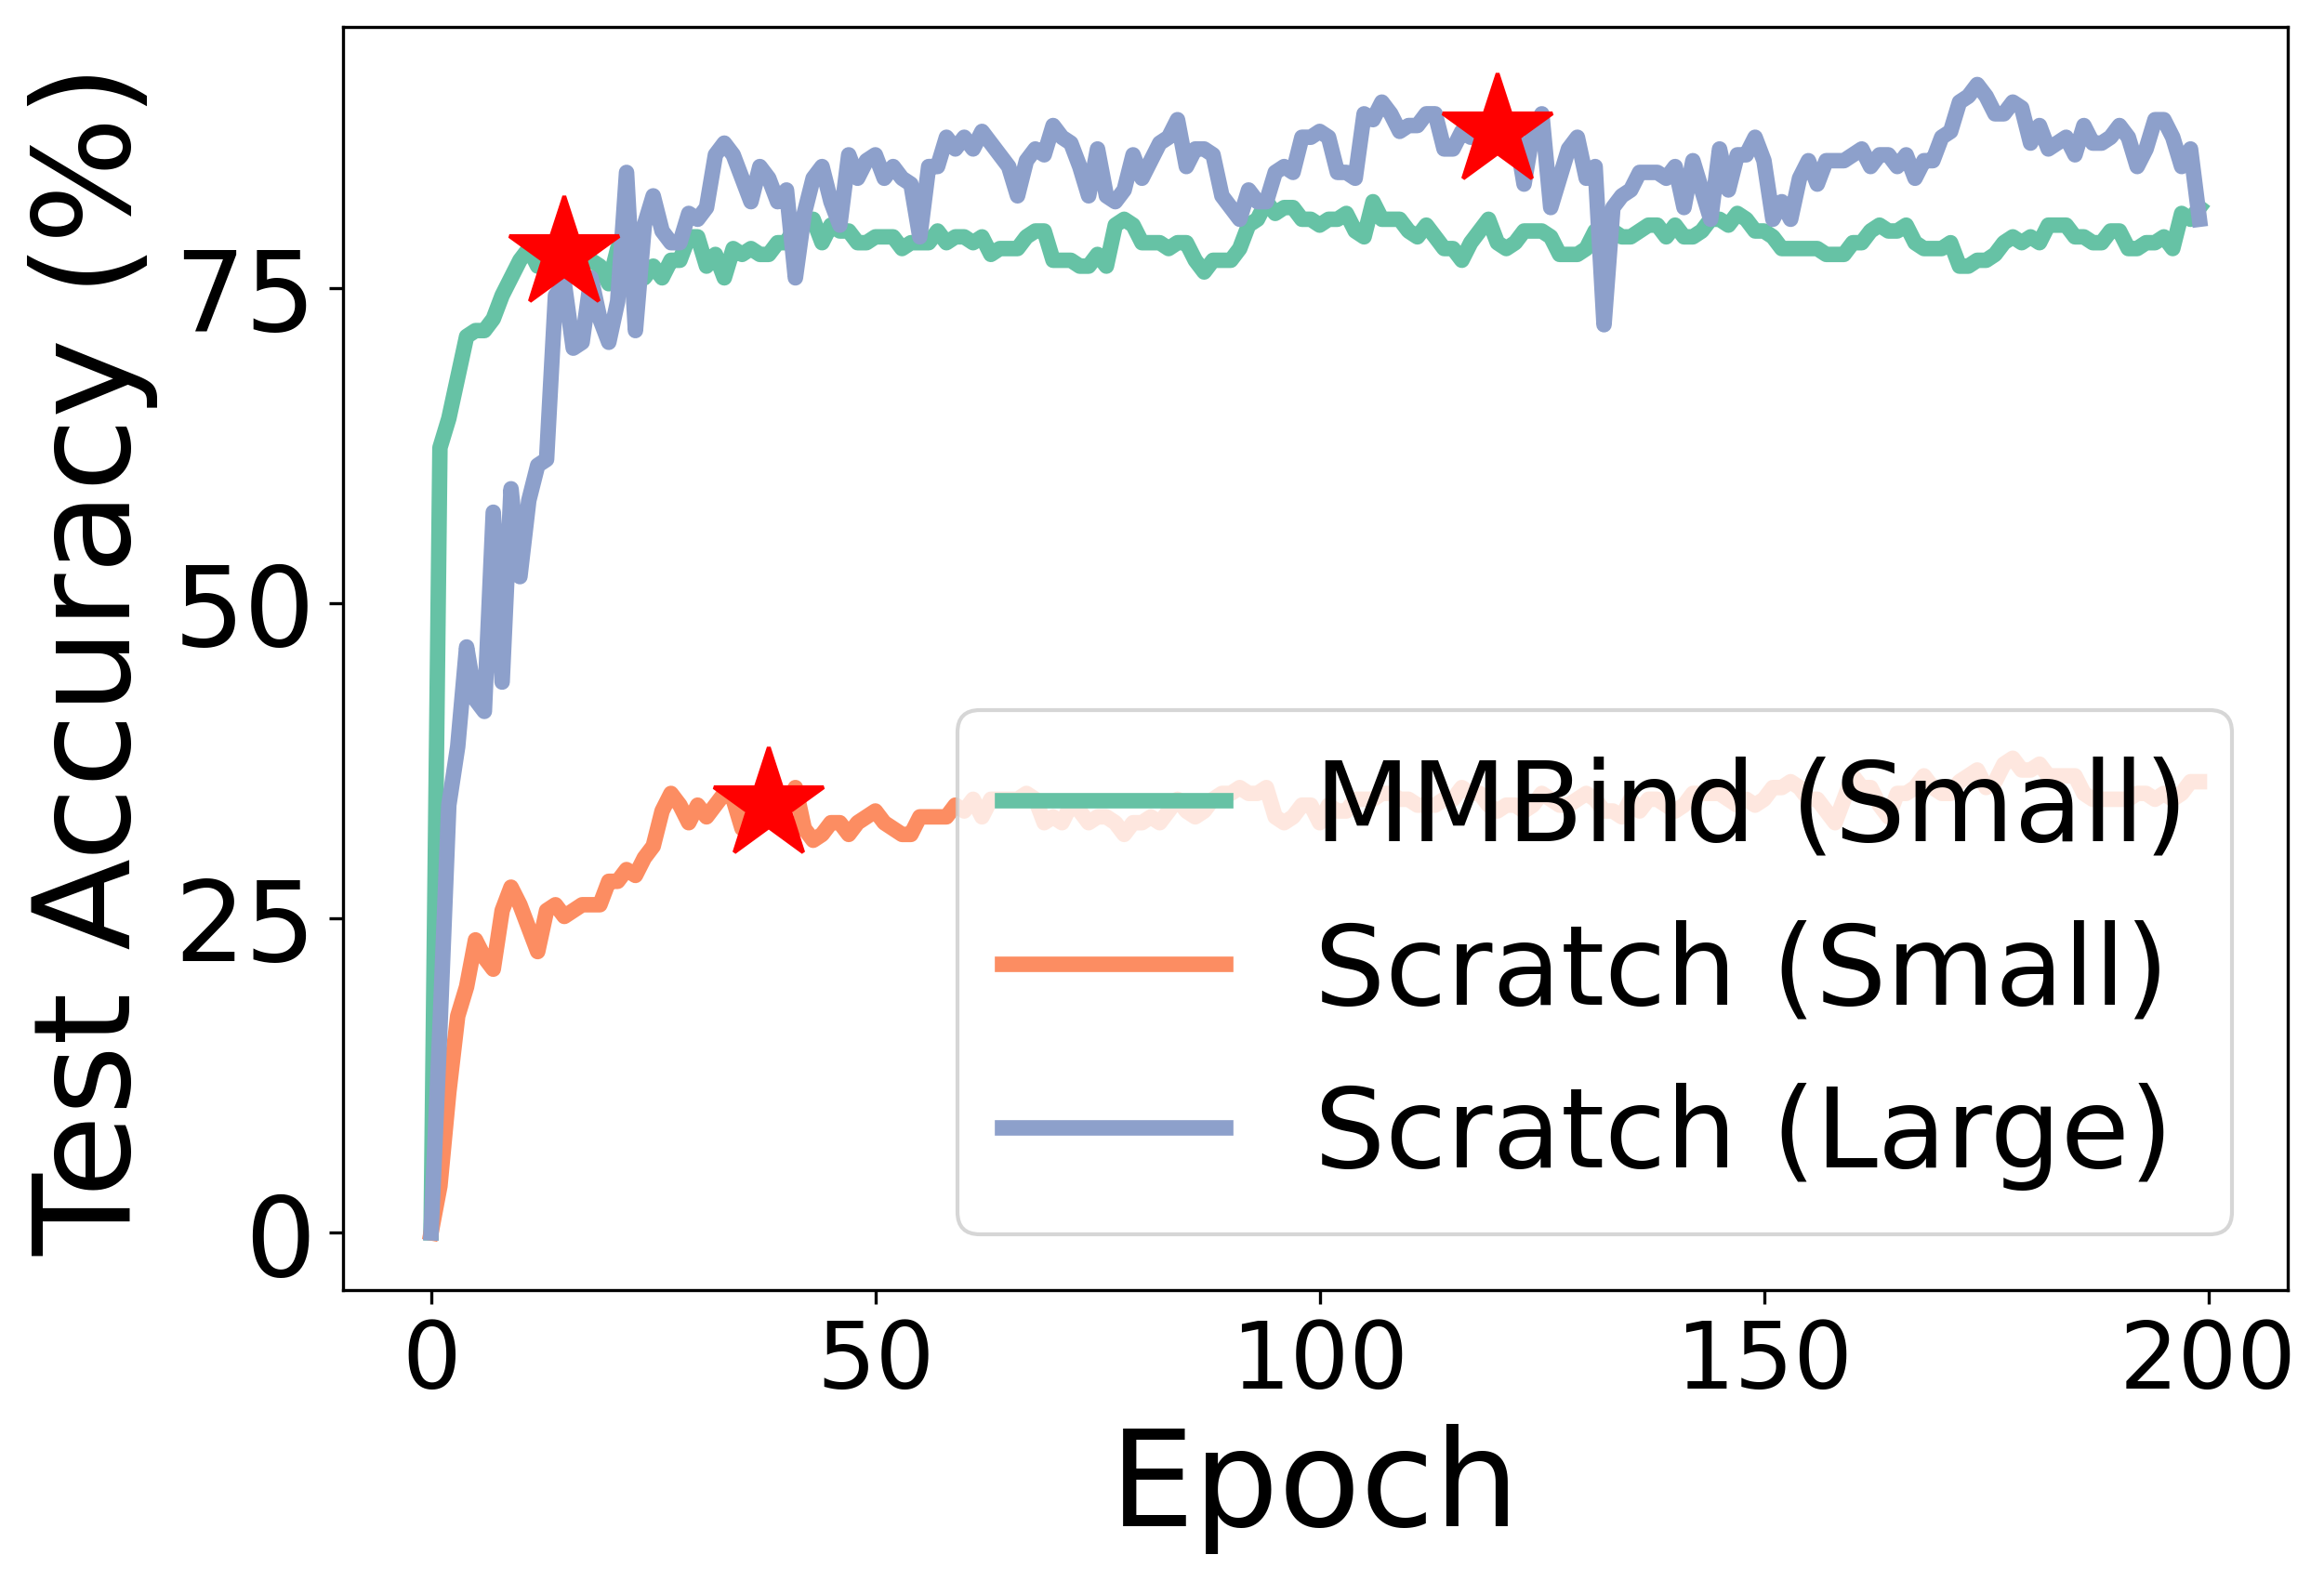
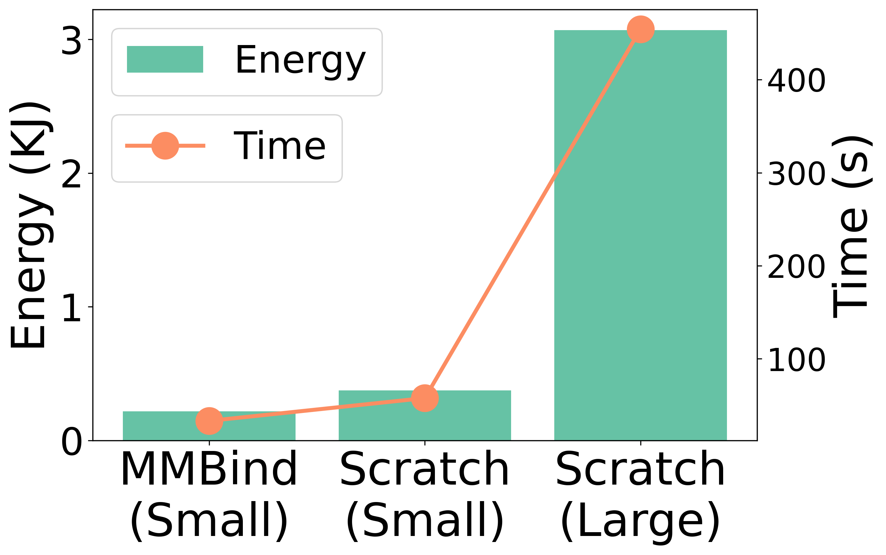
Evaluation: System Performance
Convergence
Overhead
Converge faster by training on incomplete data

Slide 14
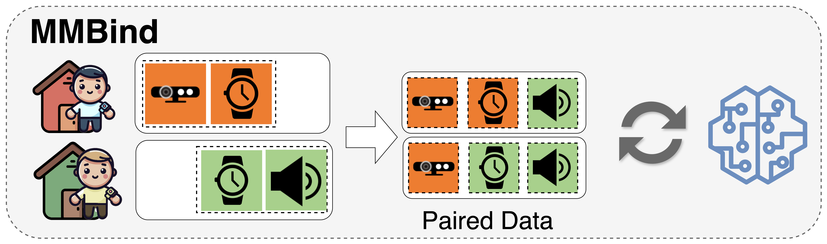
Conclusion
MMBind: A new data-bind approach for multi-modal learning in IoT
Incomplete data observing similar events can be effectively paired for multimodal training.
Generate a foundational multimodal dataset for IoT applications.
Future Work
Advanced definition of shared modalities
Beyond pairwise matching
Augmenting label binding

Slide 15
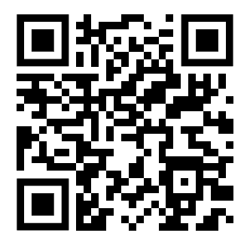
Thanks!
MMBind: Unleashing the Potential of Distributed and Heterogeneous Data for Multimodal Learning in IoT
Xiaomin Ouyang*, Jason Wu*, Tomoyoshi Kimura, Yihan Lin, Gunjan Verma, Tarek Abdelzaher, and Mani Srivastava
Github Page: https://github.com/nesl/multimodal-bind

